Slide 1
Lecture activity on Medical Robotices
Md. Kamrul Hasan, Fakrul Islam Tushar

Slide 2
Table of Contents
Introduction
Assistive Technology
Why Companion Robots?
Companion Robots
What is Robotic Surgery and Why??
Robotic Surgery Timeline
Supervisory- controlled Systems
Tele surgical systems
Shared-control systems
Advantages and disadvantages of Robotic Surgery

Slide 3

Introduction
A robot is a mechanical device that is capable of performing a variety of often complex human tasks on command or by being programmed in advance.

Slide 4
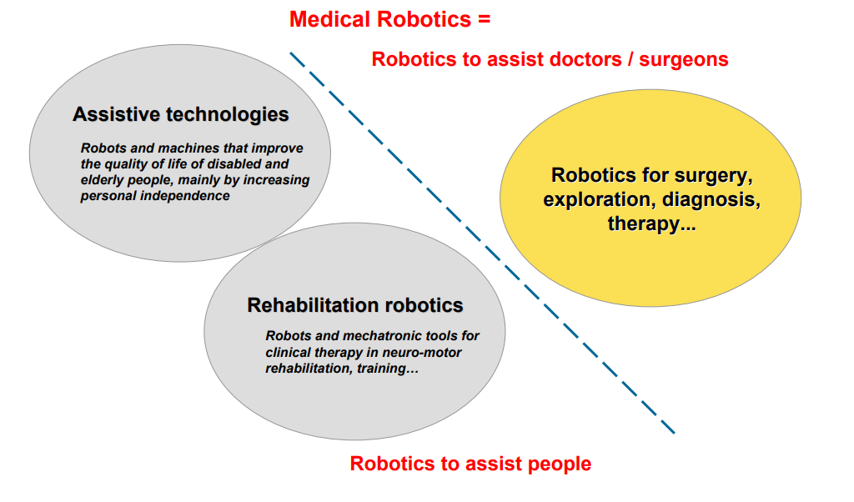
Introduction

Slide 5
Assistive Technologies
Social Robots/ Companion Robots
Robots are electronic machines programmed to do thing autonomously.
Humanoid are devices with an overall appearance based on the human body.
Social IA are computer software that are capable of intelligent behavior.

Slide 6
Why Companion Robots?
EU Figure : By 2050 32% of the Europe’s total population will be 60 and older.
USA Figure: By 2050 more than 88.5 million people aged 65 and older.
Loneliness and social isolation are already problems for many seniors and are even linked to cognitive decline and a higher death rate.
With the population of seniors expected to rise, many worry that experiences of loneliness will increase, especially if access to care is even more limited.

Slide 7
Why Companion Robots?
Early studies already show that social robots – autonomous robots trained to interact and communicate with humans – really could address issues of care and social interaction. (Wendy Moyle et al.2013).
One recent survey found that while 68% people agree robots are beneficial because they can help people, only 26 % surveyed said they’d be comfortable with a robot providing help and companionship for them if they were in hospital or care. (The Independent, 2019).

Slide 8



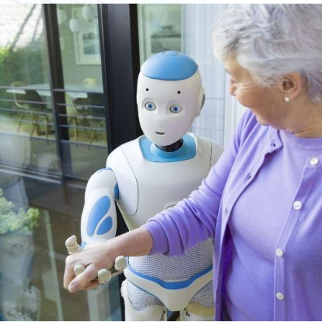

Companion Robots

Slide 9
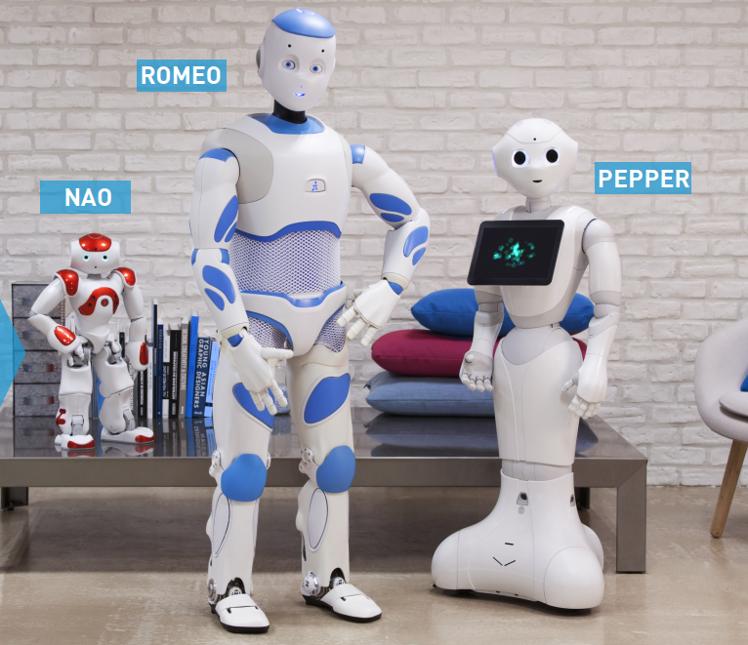
Companion Robots
SoftBack Robots
NAO
ROMEO
PEPPER

Slide 10
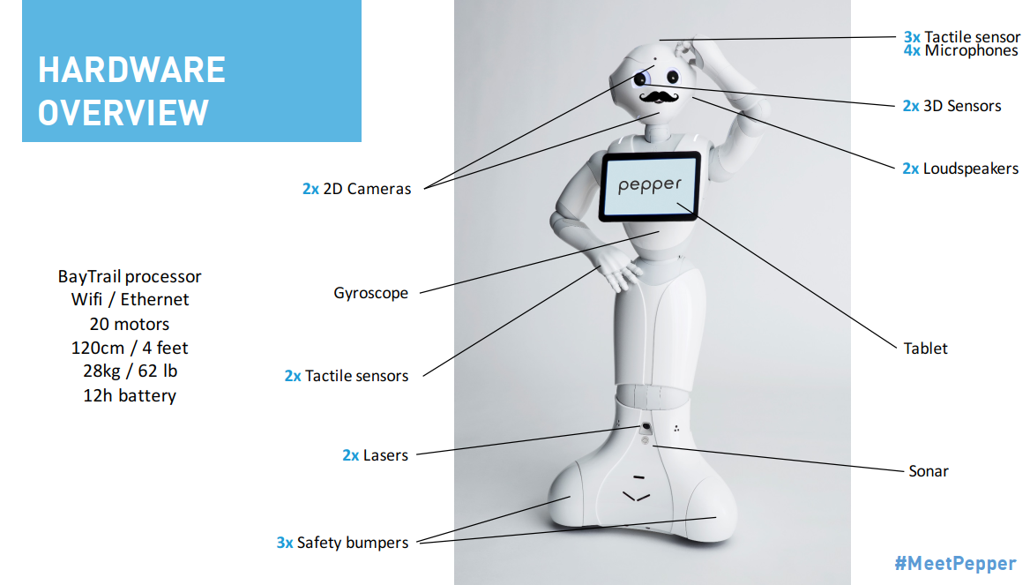
Companion Robot: PEPPER

Slide 11
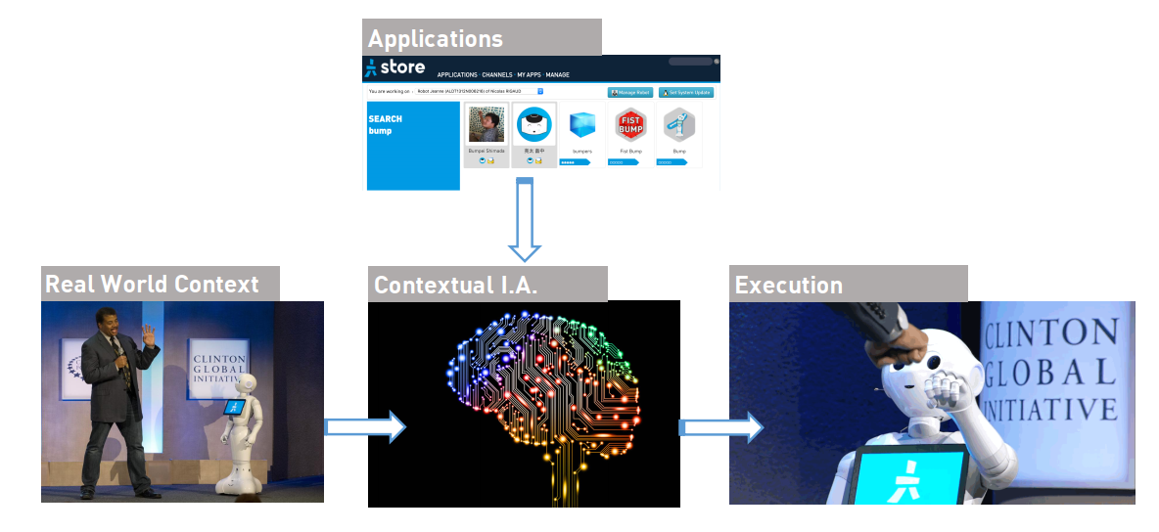
PEPPER: AUTONOMUS LIFE

Slide 12
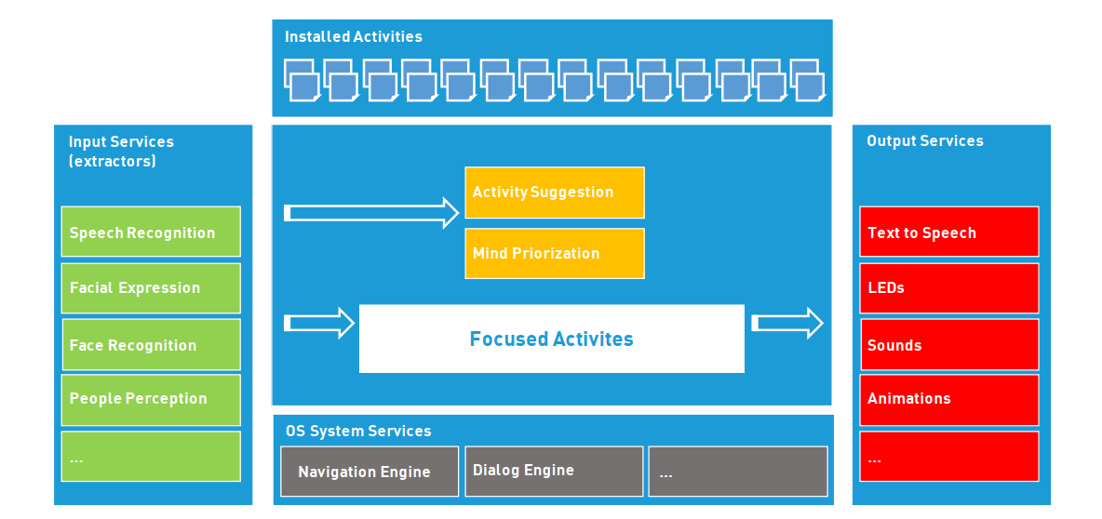
PEPPER: AUTONOMUS LIFE

Slide 13


Companion Robot: PARO
PARO is a therapeutic companion robot
It has tactile sensors and moves its tail and flippers and opens its eyes when petted
Artificial intelligence changes the behaviour based on sensors that monitor sound, light, temperature and touch.
Uses sounds to show emotions such as surprise, happiness, anger and sadness (cry). It produces sounds similar to areal baby seal and is active during the day and asleep at night.

Slide 14
Why Companion Robots?
EU Figure :People 60 and over will be 32% of the Europe’s total population by 2050
USA Figure: By 2050 more than 88.5 million people aged 65 and older.
Loneliness and social isolation are already problems for many seniors and are even linked to cognitive decline and a higher death rate.
With the population of seniors expected to rise, many worry that experiences of loneliness will increase, especially if access to care is even more limited.

Slide 15

Robot on the Surgery

Slide 16
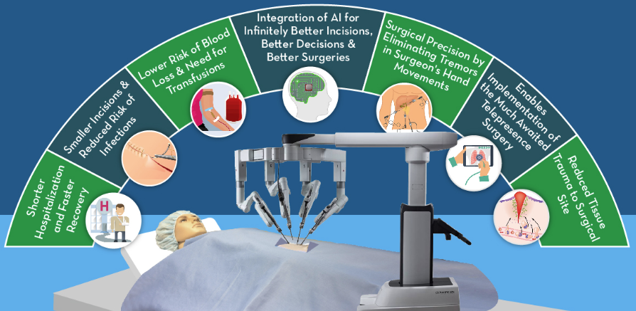
What is Robotic Surgery and Why??
Reference: Global Industry Analysts, Inc., USA

Slide 17
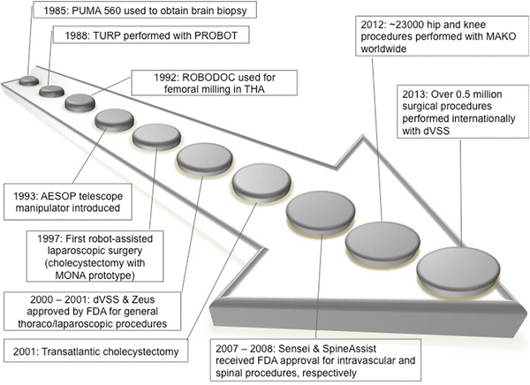
Robotic Surgery Timeline
Reference: link.springer.com/article/10.1007/s00464-016-4752-x

Slide 18
Types of Surgical Robot
Supervisory- controlled Systems
1
Tele surgical systems
2
Shared-control systems
3

Slide 19
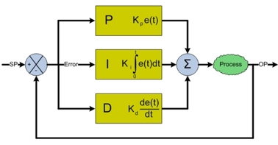
Supervisory- controlled Systems
Formatted outputs
Raw
Robot Outputs
Controlling agent
Task level controller
Control
Signals
Robot Hardware
Desired task
Generalized block diagram of Supervisory- controlled Systems
Generalized block diagram of PID controller

Slide 20
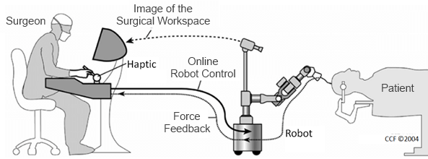
Tele surgical systems
Generalized block diagram of tele surgical systems
Reference: E. Bauzano et. al. “Planning Automatic Surgical Tasks for a Robot Assistant”.

Slide 21
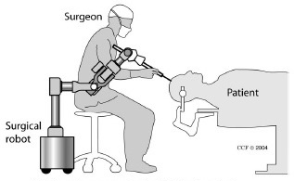
Shared-control systems
Generalized block diagram of Shared-control systems
Reference: wiki.tum.de/display/btt/Robotics

Slide 22
Advantages of Robotic Surgery
Less scarring
Faster recovery time
Tiny incisions
0% transfusion rate
Shorter catheter time
Immediate urinary control
Less post operative pain

Slide 23
Disadvantages of Robotic Surgery
The question of safety
Highly technical
The cost

Slide 24
References
Wendy Moyle et al., Exploring the Effect of Companion Robots on Emotional Expression in Older Adults with Dementia: A Pilot Randomized Controlled Trial.
The Independent. (2019). How robot carers could be the future for lonely elderly people. [online] Available at: https://www.independent.co.uk/life-style/gadgets-and-tech/features/robot-carer-elderly-people-loneliness-ageing-population-care-homes-a8659801.html
[Accessed 13 Jan. 2019].

